Slide 1
LAPERS 2024
Setting Discount Rates During Periods of CMA Volatility
September 8, 2024

Slide 2
Setting Discount Rates During Periods of CMA Volatility
A Brief History
Why is it so Important?
Actuarial Standards of Practice
Recent Volatility in Capital Market Assumptions
The Case for Conservatism

Slide 3
A Brief History – LA State Systems
Early 1990s: TRSL and LASERS Discount Rate (DR) –> 7.50%, LSERS and LSPRS –> 7.00%
With political pressure to increase the DR, and the actuaries stating they would not vote for anything higher than 8.25%, PRSAC voted to increase TRSL and LASERS discount rate to 8.25%, LSERS and State Police to 7.50%.
Supported by CMAs at the time, but proved difficult to reverse when CMAs began to reduce
2012-2013: LASERS and TRSL reduced DR to 8.00%, then gradually to 7.25%
AS CMAs continued to reduce over this period, DRs remained in reasonable range
COLA funding via gain-sharing (i.e. the Experience Account) created a need earn more than DR
Recent change to direct COLA funding phases out gain-sharing, thus no need for greater returns
Current State systems discount rates:
TRSL and LASERS –> 7.25%, LSERS –> 6.80%, LSPRS –> ​6.95%

Slide 4
A Brief History – LA Statewide Systems
Prior to 1988: most Statewide systems used a 7% valuation interest rate
Around 1988: most Statewide systems changed to an 8% valuation interest rate
At that time, most Statewide systems invested only in fixed income investments
Generally, only ~25% of assets in equities by 1995; no alternative investments.
Current average allocation is:
Fixed Income: 29%
Public Equities: 55%
Alternatives: 16%
Current Statewide system discount rates average 6.46% (range from 5.5% - 6.9%)

Slide 5
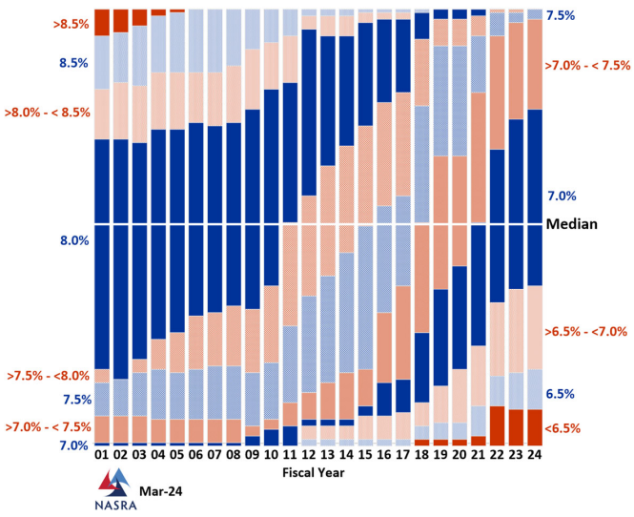
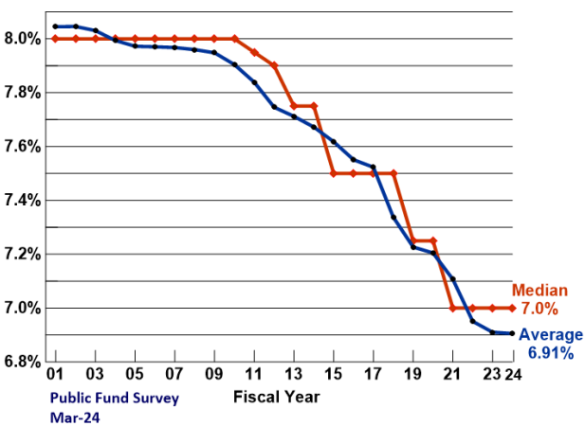
A Brief History – Nationally National Association of State Retirement Administrators - Public Fund Survey
Change in Distribution of Nominal Public Pension Investment Return Assumptions, FY01 to Present
Change to Average and Median Investment Return Assumption, FY01 to Present
Source: www.nasra.org/files/Issue%20Briefs/NASRAInvReturnAssumptBrief.pdf

Slide 6
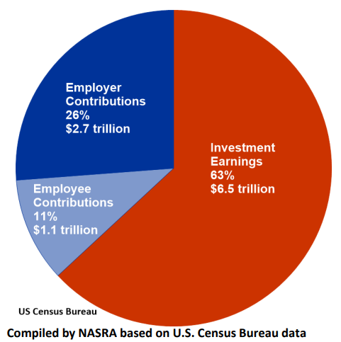
Why Is the Discount Rate So Important?
Investment earnings account for most of the revenue of typical public pension plans.
Discount rate:
Single most consequential of all actuarial assumptions, in terms of its effect on a pension plans finances and funding level
Understating overcharges current employers and taxpayers, undercharges future payers
Overstating undercharges current employers/taxpayers, overcharges future payers
Both result in a misallocation of resources, unfairly distributes costs among generations of taxpayers
Source: www.nasra.org/files/Issue%20Briefs/NASRAInvReturnAssumptBrief.pdf
Public Pension Sources of Revenue, 1993-2022

Slide 7
Actuarial Standards of Practice
Actuaries are governed by standards of practice.
Actuarial Standard of Practice (ASOP) 27:
Titled “Selection of Economic Assumptions for Measuring Pension Obligations”
Governs the setting of the valuation interest rate and/or discount rate
Does not provide actuaries with a description of how to determine the system’s discount rate assumption.
Instead, the ASOP describes items that the actuary must consider.

Slide 8
Considerations When Setting Discount Rate
The system’s Board of Trustees should first work with their investment staff and consultants to determine the appropriate level of risk tolerance
Along with risk tolerance boards must judge a plan’s maturity level and sensitivity to investment loss in determining the appropriate asset allocation
Once the target asset allocation is approved by the board of trustees, the system’s actuary can begin their analysis to set an appropriate discount rate/assumed rate of return.
Along with risk tolerance boards must judge a plan’s maturity level and sensitivity to investment loss in determining the appropriate asset allocation

Slide 9
Key Items in the ASOPs
The assumption must be appropriate for the purpose of the measurement
The assumption must reflect the actuary’s professional judgment
The assumption must take into account current and historical data relevant to the selection of the assumption
The assumption must reflect the actuary’s estimate of future experience, and/or the actuary’s observation of the estimates inherent in market data
The assumption must be expected to have no significant bias (not be significantly optimistic or pessimistic) except when provisions for adverse deviation are included

Slide 10
More About ASOPs
Due to the uncertain nature of investment returns, the actuary may consider several different assumptions reasonable for a given measurement – i.e. may set a reasonable range
Because there is room for multiple approaches and differences in professional judgment, actuaries may not always agree on the most appropriate assumption
In Louisiana, the Louisiana Legislative Auditor’s actuary provides an independent review of actuarial assumptions.

Slide 11
Plan Specific Considerations
Investment Policy and Target Asset Allocation
Effect of Reinvestment
Investment Volatility
Investment manager performance – Should we assume superior results from active management (alpha)
Cash flow timing –negative non-investment cash flows affect the need for liquidity and thus the appropriate asset allocation
Expenses paid from plan assets
Forward-looking expected investment returns (or capital market assumptions)
May set a single discount rate or use multiple investment return rates

Slide 12
Historical Experience
Although CMA’s are not set simply based on past experience, recent experience does appear to affect many investment opinions about long-term future opportunity.
After the significant stock market returns of 2021, many companies’ stock expectations decreased only to rise after large losses in 2022.
Even long-term CMA’s can experience volatility
See next slide for illustration

Slide 13
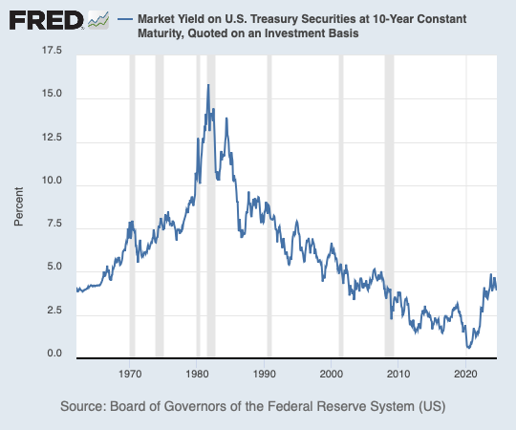
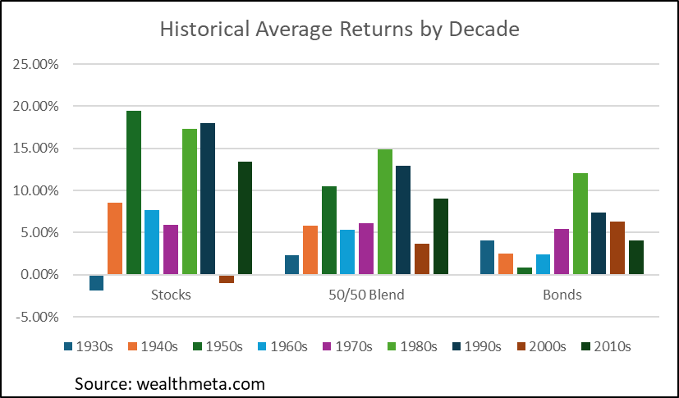
Historical Experience

Slide 14
Reasonable Range Over Time
CMAs are not static.
A single sample asset allocation using a consistent process based on consultant average CMAs produces different reasonable ranges over time.
Highly qualified investment consulting firms change their future expectations for asset class returns over time based on updated reviews of economic data.

Slide 15
Changes in Capital Market Assumptions

Slide 16
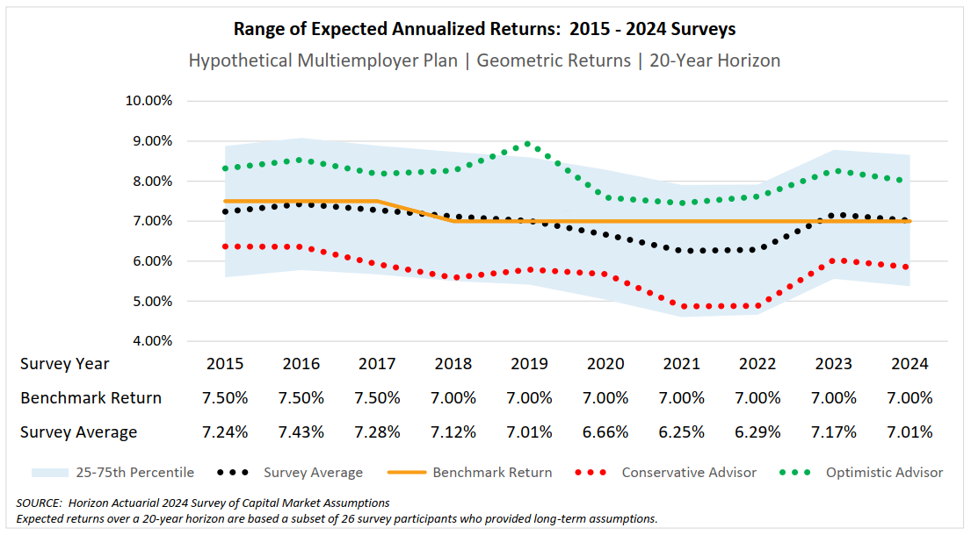
Changes in Capital Market Assumptions
Represents the expected return of the same asset allocation from 2014-2023, with slight modification in 2019 to include a small allocation to private debt.
Capital market assumptions change as economic outlooks change.
So naturally, the reasonable range for a plan’s discount rate will change over time.

Slide 17
Funding Sensitivity to Discount Rate Changes
Hypothetical Plan:
Current Payroll (Salaries): $1,000,000,000
Actuarial Funding Method: Entry Age Normal
Actuarial Value of Assets: $5,275,000,000 (75% funded ratio)
Amortization Method: 20-year amortization of the total UAL
Funding Sensitivity to Discount Rate Changes
Discount Rate | Required Contribution ($) | Required Contribution (%)
6.25% (lowest avg since 2015) | $270,000,000 | 26.9%
7.00% (current Horizon Benchmark) | $210,000,000 | 21.1%
7.50% (highest avg since 2015) | $173,000,000 | 17.4%

Slide 18
The Case for Conservatism
Don't Put the Cart Before the Horse – Asset Allocation versus Expected Investment Return
Cash Flows Matter

Slide 19
Actuarial Valuation Process
Pension Funding Equation
Actuarial Valuation Process

Slide 20
Which Came First?
Asset Allocation
Expected
Investment Return
Notes:
9 of the 13 state or statewide retirement systems (69%)

Slide 21
Portfolio Selection Process

Slide 22
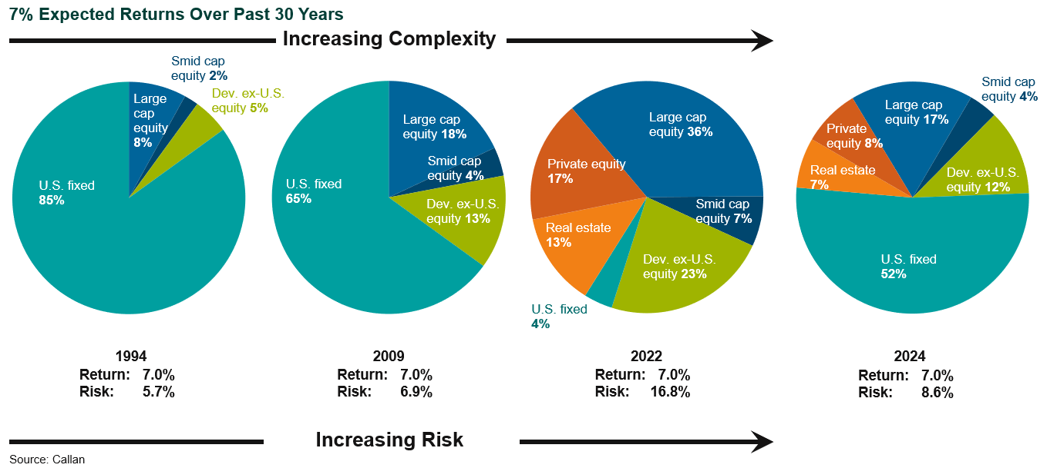
Increasing Complexity and Risk

Slide 23
What is Your Actual Goal?
Maximize investment returns
OR
Something else?
Minimizing contribution volatility or probability of contribution increases
Minimizing asset losses/maintaining and/or improving funded ratio
Maximizing probability of future PBIs
Are you tracking the right metrics for your real goals?

Slide 24
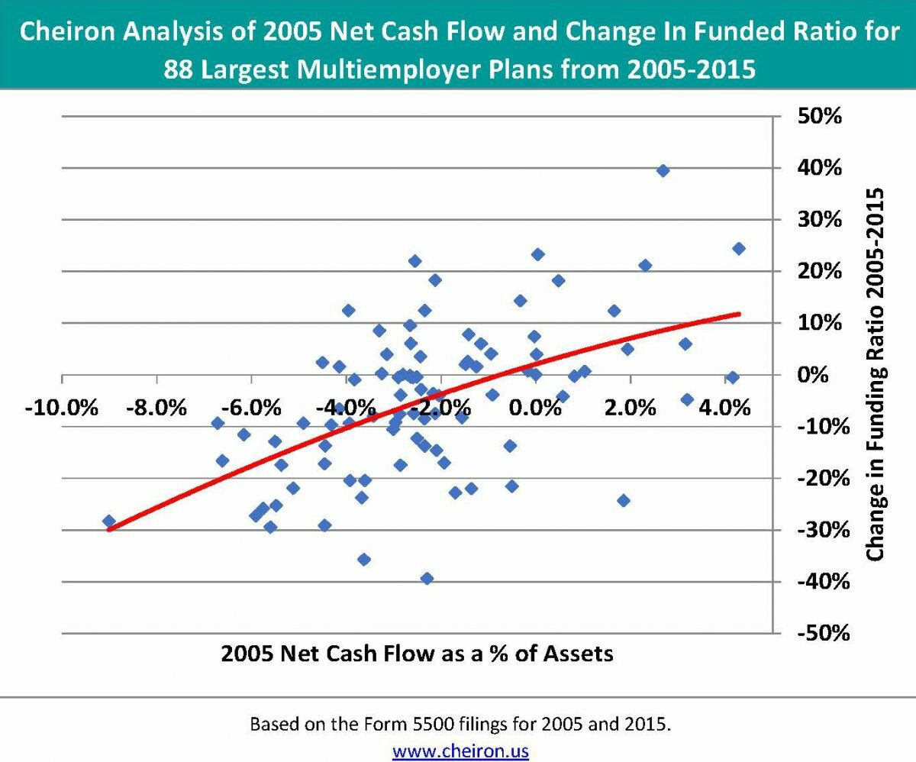
Cash Flows Matter

Slide 25
Impact of Negative Cash Flow
Beginning Assets: $100
Returns:
Year 1: -10%
Year 2: +10%
Net Non-Investment Cashflow:
Scenario 1: 4% distribution
Scenario 2: 0%
Scenario 3: 4% contribution
 | Distribution | Neutral | Contribution
BOY 1 | 100.00 | 100.00 | 100.00
Cash Flow | -4.00 | 0.00 | 4.00
$ Return | -10.00 | -10.00 | -10.00
EOY 1 | 86.00 | 90.00 | 94.00
BOY 2 | 86.00 | 90.00 | 94.00
Cash Flow | -3.44 | 0.00 | 3.76
$ Return | 8.60 | 9.00 | 9.40
EOY 2 | 91.16 | 99.00 | 107.16
Total Increase in Assets |  | 8.60% | 17.55%

Slide 26
Sequence of Return Risk
Which Return Stream Would You Prefer?
Beginning Assets: $100
Net Non-Investment Cash Flow: -$4
Return Assumption: 7.50%
 | Annual Returns
 |  | Scenario 1 | Scenario 2
Years 1 – 5 |  | 0.00% | 15.00%
Years 6 – 20 |  | 10.12% | 5.11%
Arith Avg |  | 7.59% | 7.58%
Geo Avg |  | 7.50% | 7.50%

Slide 27
Sequence of Return Risk
By year 20 assets under scenario 1 are
16% smaller than the assumed return
25% smaller than scenario 2
Initial underperformance is difficult to overcome!
Negative non-investment cash flow makes it worse
 | Annual Returns
 |  | Scenario 1 | Scenario 2
Years 1 – 5 |  | 0.00% | 15.00%
Years 6 – 20 |  | 10.12% | 5.11%
Arithmetic Avg |  | 7.59% | 7.58%
Geometric Avg |  | 7.50% | 7.50%

Slide 28
Conclusions
Single most consequential of all actuarial assumptions
Actuaries may not always agree on the most appropriate assumption, or reasonable range
OK to move slowly within reasonable range to avoid volatility in assumptions
Should not have significant bias (not be significantly optimistic or pessimistic) except when provisions for adverse deviation are included
Asset allocation and “risk” considerations should be established without regard to the assumption
Underperformance in early years is difficult to overcome

Slide 29
Questions?

