Slide 1
2024 Annual Seminar September 2024 National/Federal Update
Keith Brainard
National Association of State Retirement Administrators

Slide 2
Public pensions in the U.S.
~$6.0 trillion in assets (3/31/24)
14.9 million active (working) participants
9.4 percent of the nation’s workforce
12.0 million retirees and their survivors receive $320+ billion annually in benefits
Annual contributions = $283 billion
$221 billion from employers
$62 billion from employees
Of 4,600+ public retirement systems, the largest 75 account for 80+ percent of assets and members
Aggregate funding level = ~76%
US Census Bureau, Public Fund Survey

Slide 3
Public pensions in Louisiana
~$65 billion in assets
~196,000 active (working) participants
~191,000 retirees and their survivors receive $5.3 billion annually in benefits
More than 11 percent of the state’s residents either participates in or receives a regular benefit from a public retirement system in the state.
Annual contributions = $3.9 billion
$3.1 billion from employers
$850 million from employees
Of 29 public retirement systems, TRSLA and LASERS account for more than 60%, and the largest 5, including Parochial ERS, Muni Police and Schools ERS—account for 80+% of assets and members
Aggregate funding level = ~75%
US Census Bureau, Public Fund Survey

Slide 4
Testimonials
National Association of State Budget Officers
“As states begin fiscal 2025, overall fiscal conditions remain strong as states invest in priorities, experience stable revenue outlooks, and maintain rainy day funds at or near all-time highs.”
June 2024
S&P Global
“We expect U.S. pension funded ratios will continue their upward trajectory in fiscal years 2024 and 2025 due to steadily positive market returns.”
July 2024

Slide 5
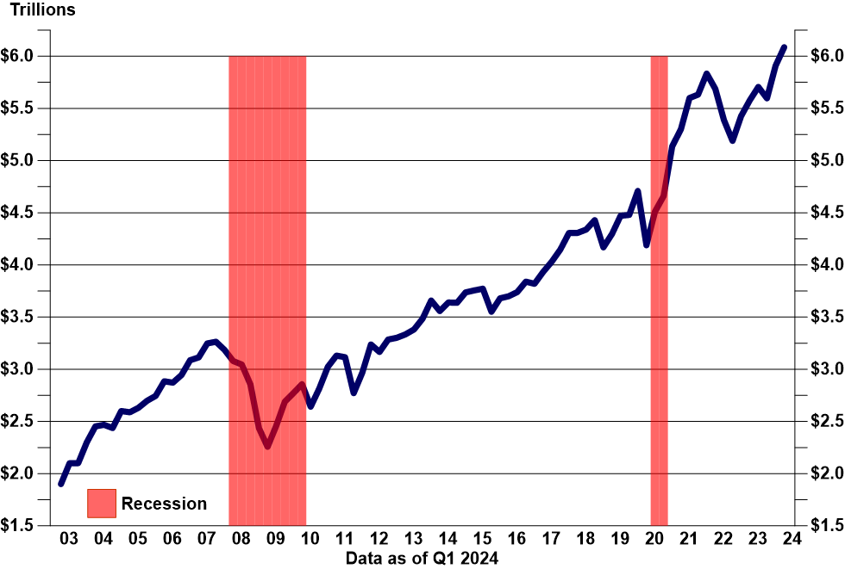
Aggregate Public Pension Fund Assets Are the Highest Ever
Federal Reserve, compiled by NASRA

Slide 6
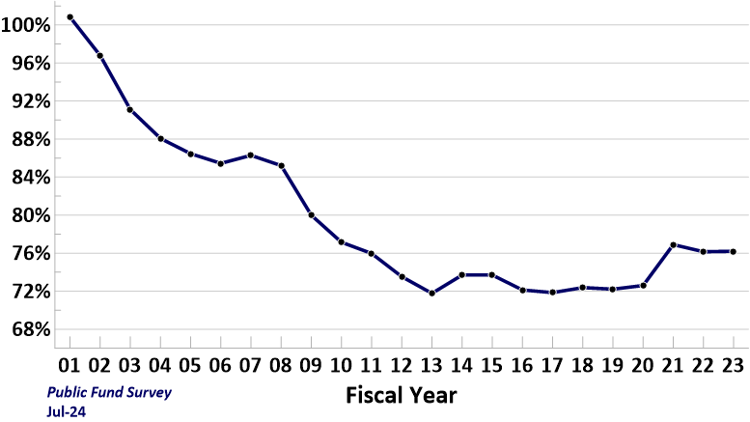
History of Aggregate Public Pension Funding Level FY 01 to FY 23
Phase-in
of 2000-02
market
losses
Reforms: lower benefits; more risk-sharing; higher contributions; lower investment return assumptions
Phase-in
of 2008-09
market
losses
Equity
growth and
surging
contributions

Slide 7
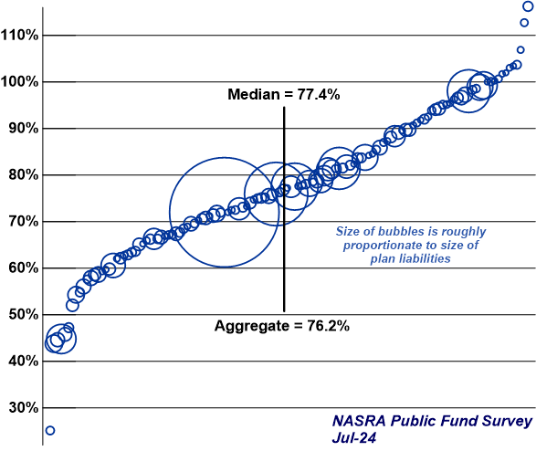
Distribution of Public Pension Funding Levels FY 23
LA Parochial
LASERS
TRSLA

Slide 8
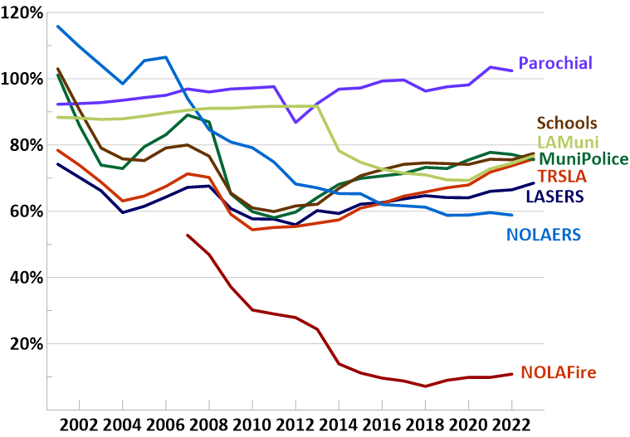
Change in Funding Ratios of Selected Louisiana Plans
Public Plan Data, Public Fund Survey

Slide 9
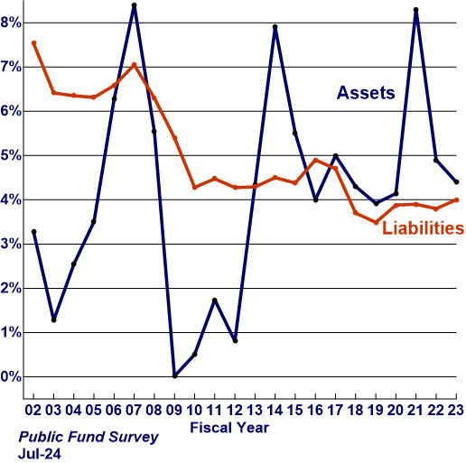
Median Annual Change in Aggregate Actuarial Assets and Liabilities

Slide 10
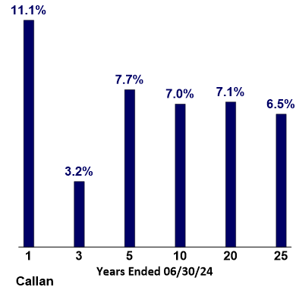
Median Annualized Public Pension Fund Investment Returns for Periods Ended 6/30/24

Slide 11
Public Fund Returns by Size: Smaller Funds Outperformed Larger Funds
Fiscal Year returns period ending June 30, 2024
14.0 |  |  | 12.5 |  |  | 11.5 | 12.9 | 13.1 | 25th Percentile
12.0 |  |  |  | 10.7 | 10.8 |  | 11.7 | 12.0 | Median
10.0 | 11.1 |  |  | 10.1 | 10.2 | 10.2 | 10.3 | 10.9 | 75th Percentile
8.0 |  | 9.7 |  | 8.5 | 9.2 | 8.9
Return
Percent
6.0
4.0
2.0
0.0
Total PF
PF > $25B
PF > $10B
PF > $1B
PF $100M-
$1B
PF < $100M
25th Median 75th
Smaller plans outperformed larger plans for the fiscal year as a result of lower real estate and alternatives allocations.
Number of members in each group: Total PF 329; PF > $25B 25; PF > $10B 54; PF > $1B 126; PF $100M - $1B 125, PF < $100M 78
Knowledge. Experience. Integrity.
NASRA 2023 Annual Conference 5

Slide 12
Contributions

Slide 13
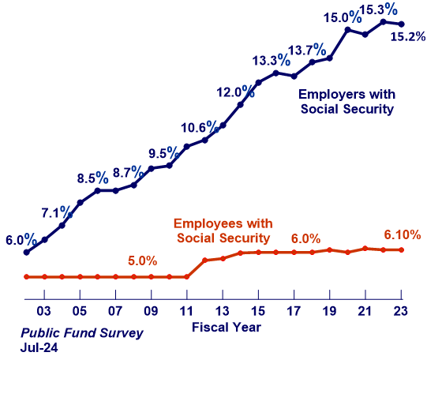
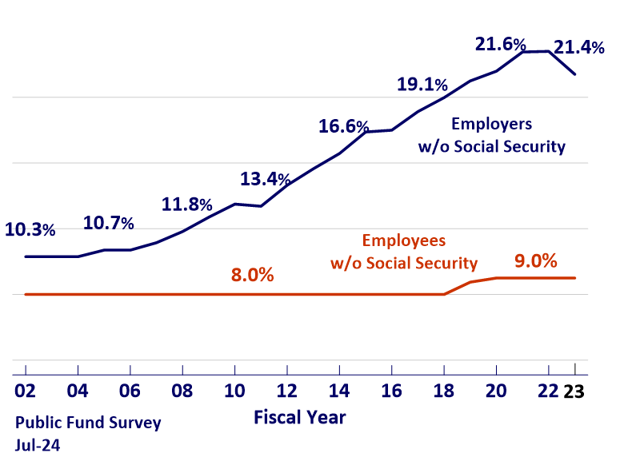
Median Contribution Rates Employee and Employer Social Security-Eligible and -Ineligible
Social Security-Eligible
Social Security-Ineligible
Contribution rates reflected here are those for general employees and teachers and predominantly exclude rates for public safety personnel.

Slide 14
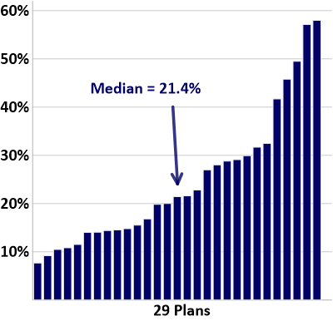
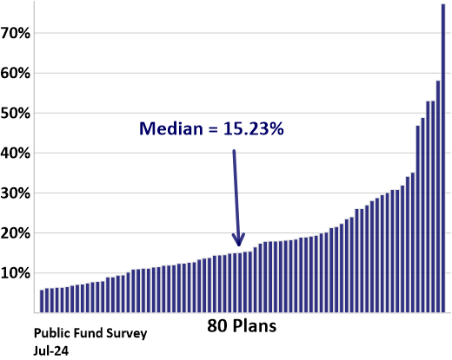
Distribution of Employer Contribution Rates Social Security–Eligible and –Ineligible, FY 23
Social Security-Eligible
Social Security-Ineligible
Contribution rates reflected here are those for general employees and teachers and predominantly exclude rates for public safety personnel.

Slide 15
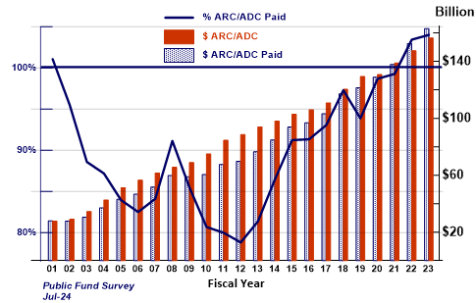
ARC/ADC Experience, FY 01-FY 23 111 Plans

Slide 16
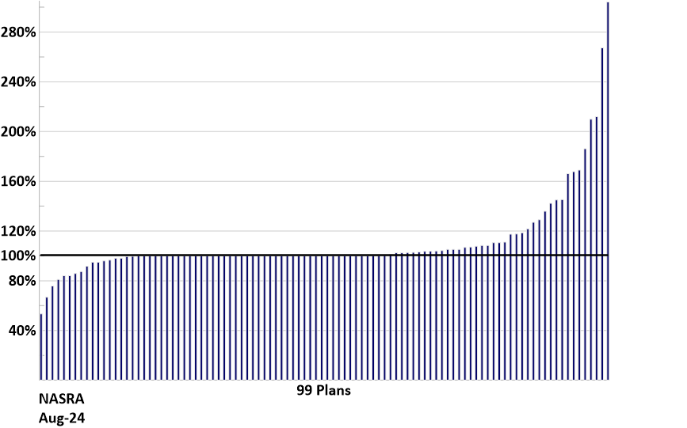
ARC/ADC Experience, FY 23 111 Plans

Slide 17
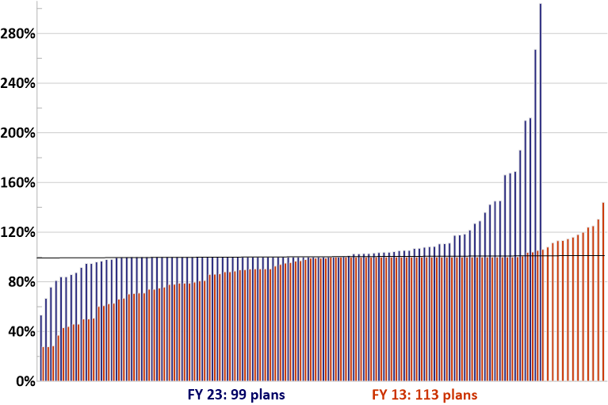
Comparison of FY 23 and FY 13 ARC/ADC Effort

Slide 18
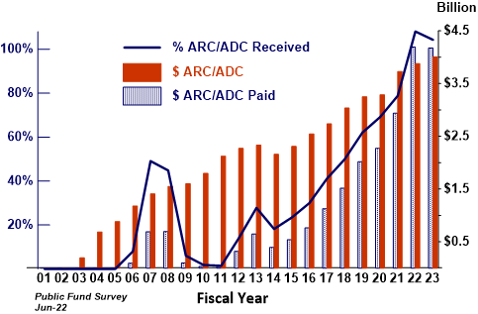
ARC/ADC Experience, FY 01-FY 23 New Jersey TRS

Slide 19
Median Annual Change in Actives and Annuitants

Slide 20
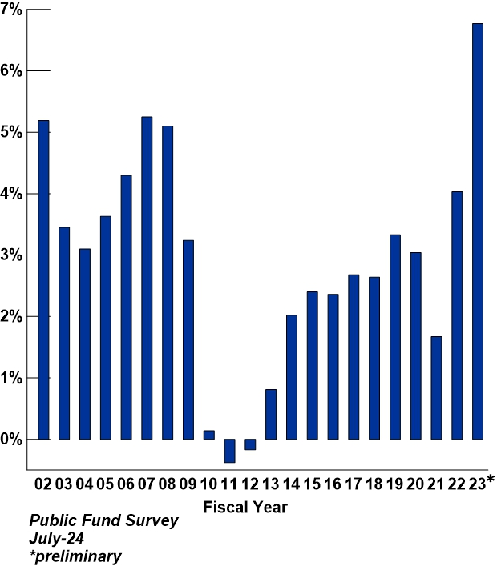
Median Annual Change in Payrolls FY 02 to FY 23

Slide 21
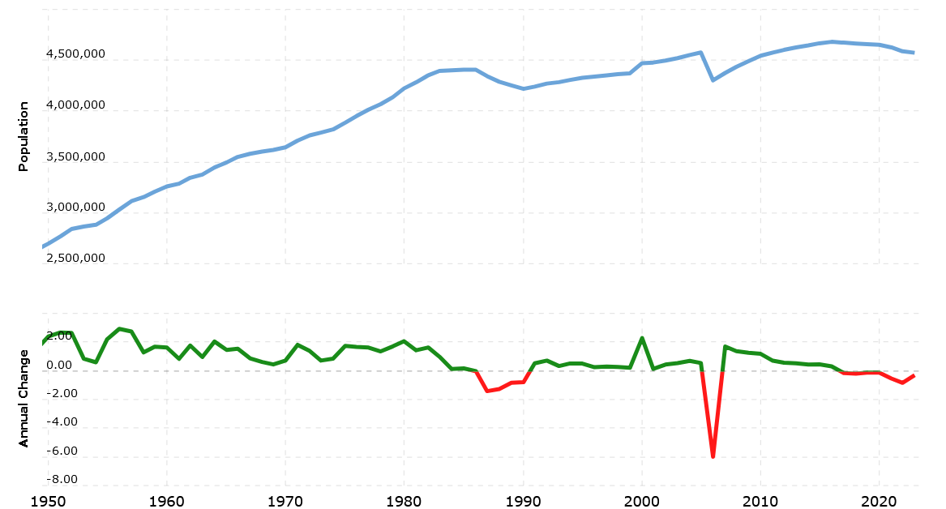
Change in Louisiana State Population, 1950 to 2023
Macrotrends

Slide 22
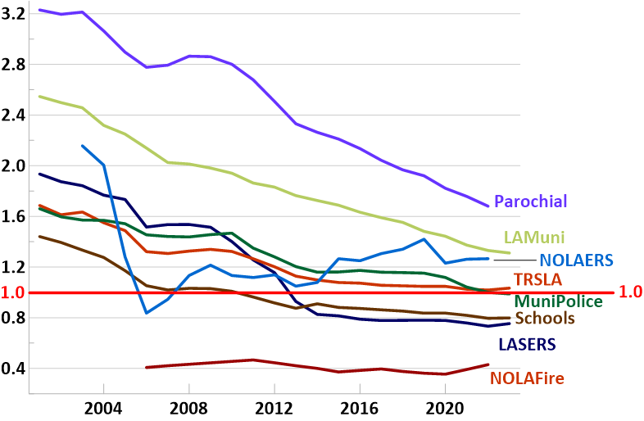
Change in Number of Active Members per Annuitant for Selected Louisiana Plans
Public Plan Data, Public Fund Survey

Slide 23
Actuarial
Assumptions

Slide 24
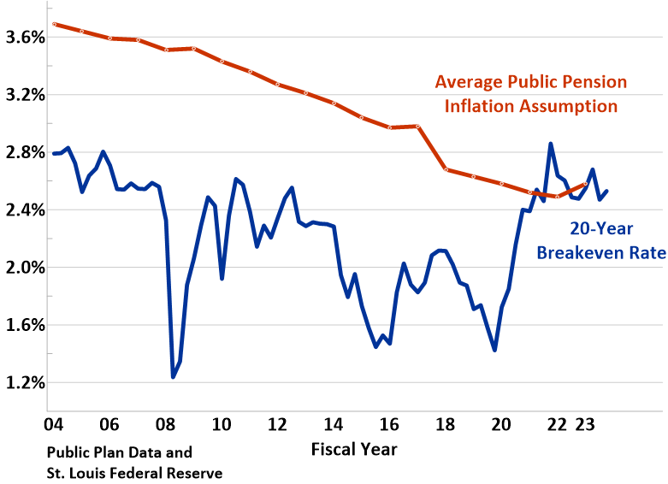
Average Public Pension Plan Inflation Assumption vs. 20-Year Breakeven Rate
The breakeven rate is a measure of expected inflation derived from 20-Year Treasury Constant Maturity Securities and 20-Year Treasury Inflation-Indexed Constant Maturity Securities. The latest value implies what market participants expect inflation to be in the next 20 years, on average.

Slide 25
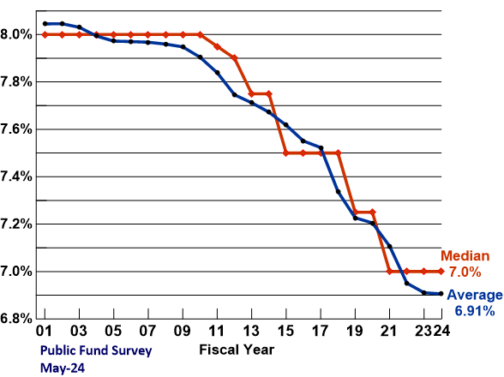
Change to Median and Average Nominal Investment Return Assumption

Slide 26
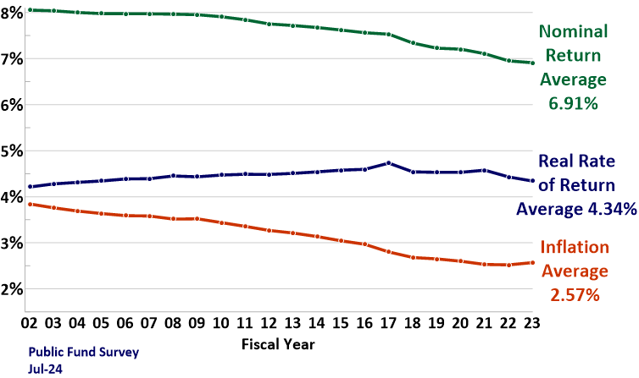
Change in Assumptions for Nominal and Real Rate of Return and Inflation

Slide 27
Federal Issues

Slide 28
ESG and Proxy Voting
A Congressional resolution to repeal the Biden ESG Rule passed but was vetoed in 2023.
That rule would have permitted consideration of non-financial factors in making investments.
Bills and hearings in the U.S. House followed, mostly focused on federal regulators and proxy advisory firms, but also asset managers and ERISA plans, and to a lesser extent, public plans - where most of the ESG activity was happening.

Slide 29
ESG and Proxy Voting
This year, more federal activity aimed at public plans:
Legislation was introduced to prohibit retirement plan consideration of factors other than financial risk and return
Congress held hearings and issued information requests on investor ESG activities and whether they violate anti-trust laws
Congress sent letters to the IRS commissioner inquiring whether public plan investment activities violate the Internal Revenue Code, and if amendments to the IRC or ERISA are needed.
A divided Congress makes enacting legislation in this area unlikely this year. Expect continued activity and press events, and possibly more to come.

Slide 30
China
Investment in China is a bipartisan issue – both sides of the aisle, current and former administrations.
An Executive Order was issued and proposed rulemaking is underway to address the flow of U.S. money to China, particularly in certain industries (AI, quantum, microprocessors) that could compromise national security and U.S. intellectual property.
NASRA has participated in meetings with administration officials and submitted comments on proposed rules relaying support for federal efforts to ensure entities that pose national security threats are denied access to all U.S. investors and the capital marketplace, and suggestions to limit unintended consequences.

Slide 31
China
Various Congressional proposals would impose an alternative approach. Some were nearly included in defense spending bills and could be attempted again.
A new House Select Committee on the Strategic Competition Between the United States and the Chinese Communist Party was established at the beginning of this Congress and is expected to continue bipartisan hearings and investigations next year.
Legislation to bar tax-exempt investors, including public plans, from investing in China has been introduced in both chambers but is not expected to move this year.

Slide 32
Renewed Bailout Discussions
National Review magazine has called on Republicans to promise not to bail out state pensions.
Nearly every state has made significant pension reforms, retirement system assets are at record levels, pension funding is at its highest since the Global Financial Crisis, actuarial assumptions are notably more conservative, and no public pension fund is asking for federal assistance.
The Republican Study Committee FY25 Budget Proposal includes a provision to prohibit the Department of the Treasury and the Federal Reserve Board from providing any form of financial assistance to a state or local pension plan, and to deny state governments access to federal bankruptcy proceedings, even though national public sector organizations have been on record (for decades) opposing both.

Slide 33
Tax Reform/Revenue Raisers
With expiration of many provisions in the 2017 Tax Cuts and Jobs Act looming, Congress may reconsider many of the revenue-raising tax provisions (i.e pay-fors) originally included in the House-passed version of the bill that would have impacted public plans. Notably:
Application of the Unrelated Business Income Tax to state and local government pension plan investments
Requiring all elective contributions to retirement plans to be made on an after-tax/Roth basis
Application of 10% early distribution penalty to governmental 457 plans
Repeal of special catch-up rules for 457 and 403(b) plan
Although none of these measures were included in the final bill, it was close
Discussions have been underway that all revenue-raisers will be back on the table, particularly those affecting tax-exempt entities. While possibly aimed mostly at endowments, universities and foundations, public plans also could be swept into these issues.

Slide 34
SECURE 2.0
Some provisions in the SECURE 2.0 legislation (enacted in December 2022) applied to public plans, but some were technical issues.
There were significant administrative issues with a new provision that would require catch-up contributions to be made on an after-tax (Roth) basis for anyone with FICA wages exceeding $145,000 in the previous year.
While IRS provided relief last summer extending the effective date, problems remain, which will likely need to carry over to the next retirement security or tax bill.

Slide 35
GPO/WEP/Social Security
There has been an increasing amount of activity surrounding the Government Pension Offset and the Windfall Elimination Provision, which apply to state and local government workers not covered by Social Security.
Bills to repeal these offsets now have over 300 cosponsors in the House and over 60 cosponsors in the Senate.
Neither chamber is expected to have time this year to consider these bills on their respective floors.

Slide 36
GPO/WEP/Social Security
Members of the committees with jurisdiction over Social Security (House Ways & Means and Senate Finance) have stated repeatedly that the offsets should be reformed—but not repealed—as repeal would create new inequities and hasten depletion of the Social Security Trust Funds.
Modifications to the offsets will move only with larger reforms to strengthen Social Security, which are not on the table this year.

Slide 37
GPO/WEP/Social Security
Renewed efforts to repeal the offsets and to address the looming exhaustion of the Social Security trust funds have spurred new interest in mandatory Social Security coverage for newly hired state and local government workers.
New reports on the issue were recently released by the Congressional Research Service and the Conference Board.
A recent GAO paper on Social Security Reform Options noted that mandatory Social Security coverage would initially improve the program’s finances because these employees would start paying payroll taxes, while initially receiving few benefits, but this change would worsen Social Security’s long-term financial outlook.

Slide 38
Thank you
Keith Brainard
keith@nasra.org
202-624-8464

