Slide 1
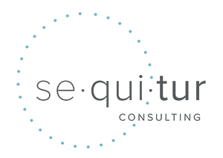
Best Practices for Retirement Boards
Doreen Brasseaux
Beverly Haydel

Slide 2
Governance versus Management
Fiduciary Duty
What Good Governance Looks Like
What Good Management Looks Like
Effective Board Chair
Effective Executive Director

Slide 3
THIS IS MY LANE
The difference between governance
and management

Slide 4
Governance VS Management
Meaning
Developing the policy and strategies of an organization | Looking after the routine operations of the organization to ensure they are consistent with the organizational mission
Obligation
Governing the organization | Managing the organization
Related To
Vision of the organization | Making decisions to ensure the policies determined by the governing body are followed
Orientation
Strategy and vision-oriented | Task-oriented
Responsible Party
Board of directors | Executives and managers

Slide 5
GOVERNANCE FUNCTIONS

Slide 6
Providing financial oversight and transparency
Selecting and evaluating leadership
Participating in strategic planning
Offering insights and advice on key issues and their best fixes
Recognizing, identifying and managing risks and crisis in a strategic manner
Ensuring compliance with the government regulations
Meeting fiduciary duty

Slide 7
WHAT FIDUCIARY DUTY IS AND WHAT IT ISN’T

Slide 8
Protect the organization from conflicts of interest
Protect the organization from illegal behaviors by staff, advisors, consultants, and other board members
Protect the fund from misuse of power
Provide greater transparency and accountability
Promote a higher level of professionalism from the board and the organization’s leaders

Slide 9
Duty of Care
Duty of Loyalty
Duty of Obedience
Duty of Confidentiality
Duty of Prudence
Duty to Disclose

Slide 10
What constitutes breach of fiduciary duty?

Slide 11
Doing or saying something that is not in the Fund’s best interest. In a legal sense, the breach must also have resulted in some loss for the Fund and the breach must have directly caused the damage.
Using your position for personal gains, such as awarding contracts to your own business(es) or engaging in transactions that benefit you personally at the expense of the organization.
Not disclosing or properly managing conflicts of interest, which can undermine the integrity of decision-making.
Failing to provide sufficient oversight of executive leadership, allowing mismanagement or unethical behavior to persist without appropriate intervention.
It is NOT a breach of fiduciary duty if the Fund experiences a loss due to market activity.

Slide 12
MANAGEMENT FUNCTIONS

Slide 13
Creating and implementing policies and strategies
Developing and supervising yearly business plans
Recruiting managers and staff members
Backing policies established by the governing body
Executing the decisions of the board
Measuring performance of the organization
Dealing with strategic and operational risk.

Slide 14
What does GOOD governance look like?

Slide 15
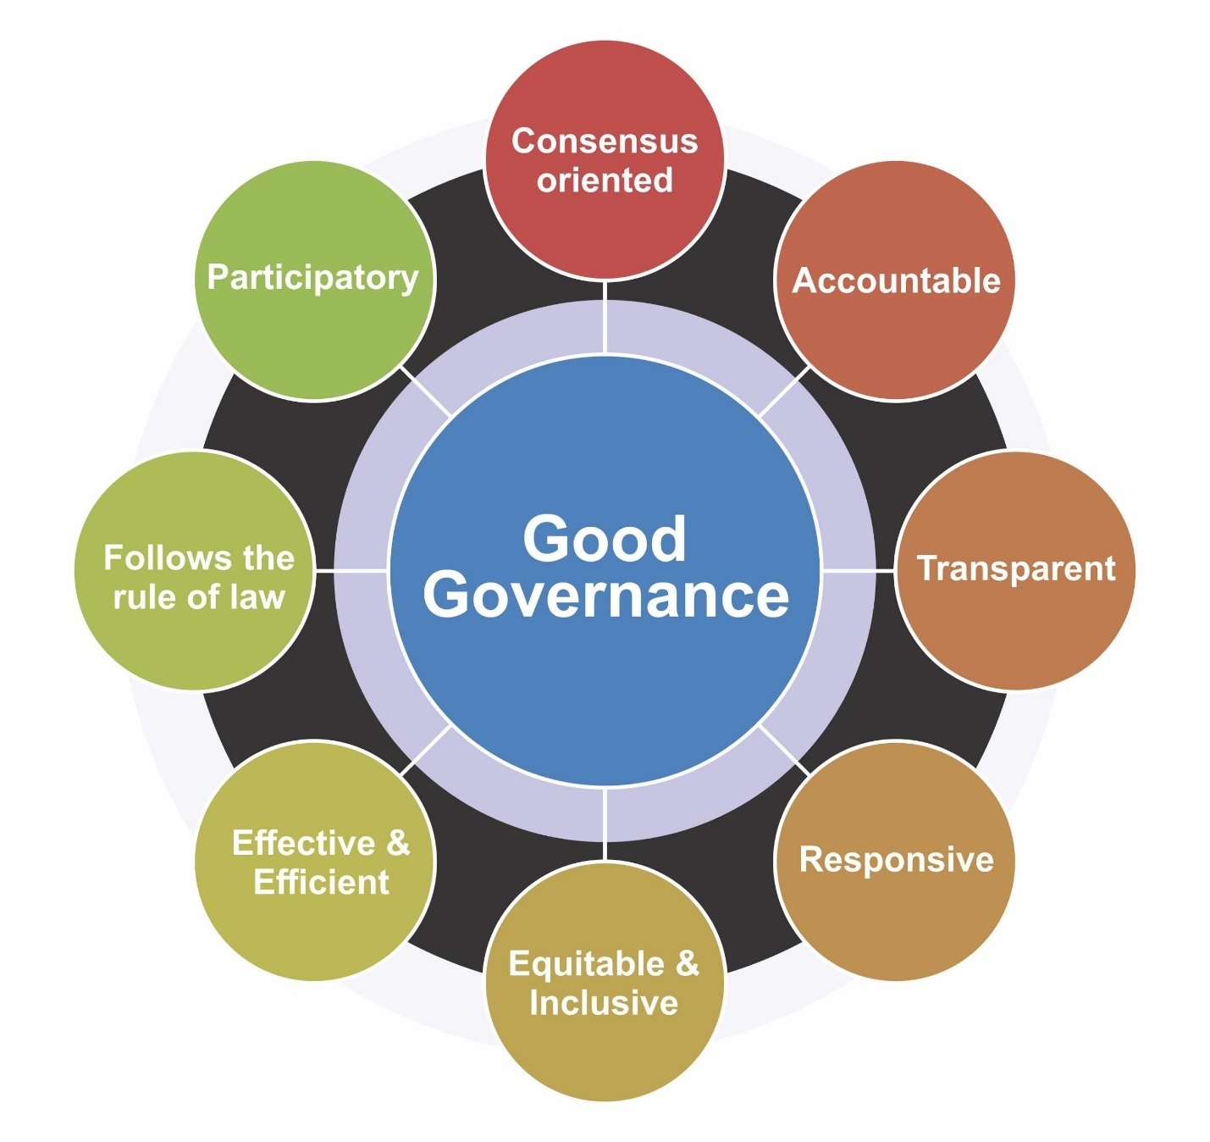
Source: The Wharton School, UPENN

Slide 16
WHEN HAVE I CROSSED THE CENTER LINE?

Slide 17
Interfering with the authority of the Executive Director to manage the day-to-day operations
Working around Executive Director directly with staff unless an established practice is involved such as committee chairs communication with staff assigned to a committee
Trying to get a preferred candidate hired by LASERS
Trying to direct a contract to a preferred vendor
Contacting media for off- or on-the-record to voice opinions about actions of the board or legislation impacting public retirement laws and policies
Undermining majority board votes

Slide 18
Example of a board member crossing center line:
A local non-profit board votes to support a local measure that would change zoning regulations in their municipality. One board member — let’s call him “Beau” — was outvoted. The staff posted the Board’s position on the organization’s website. Now, Beau keeps emailing the staff and telling them to change what’s on the website or even to take it down. The staff is spending hours talking with Beau on the phone about it.

Slide 19
Example of a board member crossing center line:
A public state board votes to privatize the utility services operated by the organization it governs. Following a public procurement process, the board votes to contract with Firm A. The vote to approve the contract with the prevailing vendor results in a 10-1 vote. The dissenting board member is contacted by the media (or worse, contacts the media) to criticize the vote and explain why she thinks it’s a bad decision. The resulting article uses the board’s official statement on the vote and quotes the dissenting board member in the article.

Slide 20
Damage to Organizational Reputation
Legal and Financial Risks
Erosion of Trust and Morale
Ineffective Governance
Strategic Drift
Decreased Board Effectiveness
Conflict of Interest
Regulatory Scrutiny
Failure to Achieve Mission

Slide 21
CHARACTERISTICS OF AN EFFECTIVE BOARD CHAIR

Slide 22
Strong Leadership
Effective Communication
Strategic Vision
Collaboration and Team Building
Ethical Integrity
Supportive Relationship with the Executive Director
Facilitation Skills
Commitment to the Organization
Knowledge of Governance
Adaptability and Problem-Solving
Commitment to Diversity and Inclusion

Slide 23
CHARACTERISTICS OF AN EFFECTIVE EXECUTIVE DIRECTOR

Slide 24
VISIONARY LEADERSHIP
STRONG COMMUNICATION SKILLS
FINANCIAL ACUMEN
ADAPTABILITY AND PROBLEM-SOLVING
OPERATIONAL EXCELLENCE
ETHICAL INTEGRITY
RELATIONSHIP BUILDING
BOARD RELATIONS
PASSION AND COMMITMENT
CULTURAL COMPETENCY
GLOBAL PERSPECTIVE

Slide 25
FINAL TAKE AWAY

