Slide 1
Is Real Estate on Life Support or Road to Recovery
LAPERS Annual Conference
Jeffrey Boucek, CFA
Sr. VP and National Director of Public Fund Investment Consulting
Linda McDonald
Sr. VP, Hard Assets Research
September 10th 2024

Slide 2
Real Estate
Market Update
General Education
Investor Sentiment
Real Estate Outlook
Sector Spotlight
Appendix

Slide 3
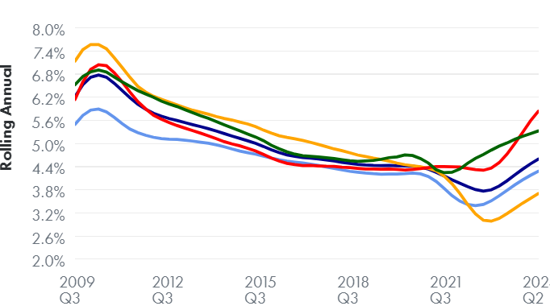

Impact of Higher Rates on Cap Rates
Annual Cap Rates: NCREIF Property Index
Monetary tightening significantly impacting Real Estate markets
  Higher interest rates resulting in increasing cap rates and decreasing valuations
  Cap rate expansion felt across the board, but significant disparities
  Ended Q2 at 4.7%, from a low of 4.0%
  Significant disparities across property types
  Transactional cap rates higher than for appraisal cap rates
    Also significantly higher for non-core assets
Source: NCREIF

Slide 4
Tightening Debt Markets: Traditional Lenders Retreat
US Debt Originations in Bn
Higher borrowing costs and reduced availability of financing
  Regional and larger bank pull-back: At over 60% banks represent the largest share of CRE loans outstanding
  Stricter liquidity and capital requirements have forced banks to rein in their lending activities as such banks have limited ability to originate new loans or re-finance existing loans.
  Bank failures such as Silicon Valley Bank, Signature Bank, and First Republic, further exacerbating bank retrenchment
  Traditional lenders being much more selective
Source: Real Capital Analytics, Federal Reserve

Slide 5
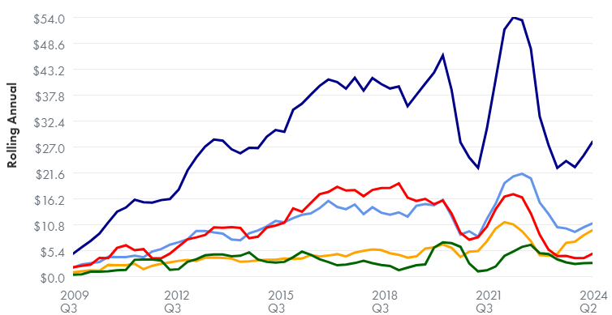
Transaction Market Stalled
U.S. Transaction Volume By Property Type
Real estate market facing significant liquidity challenges
  Deal volume remains tepid in Q2 2024, after weak 2023
  Bid/ask spreads have widened
  Uncertainty on financings and valuations
  Limited availability of debt
Transaction Volume in Bn
U.S. Total U.S. Apartment U.S. Industrial
U.S. Office U.S. Retail
Source: MSCI Real Assets, SitusAMC Insights

Slide 6
Property Values Below Pre-Covid Levels
Post-pandemic gains effectively wiped out
  The market value of properties in NPI declined for eight straight quarter and returns were negative for the seventh straight quarter
  Third most significant period of value declines in the 45-year history of NCREIF Property Index
    Decline of approximately 16% since the peak in Q2 2022 versus approximately 30% during the GFC
  Unlike other two periods, this downturn was not preceded by nor coincided with a recession
NPI Historical Returns
Source: NCREIF

Slide 7
Significant Disparities Across Sectors
Bifurcation across real estate sectors - widest dispersion in over 40 years
  Industrial strongest performer across all periods and only positive sector during pandemic with 4.1% return
  Retail most impacted during Covid, down 4.3%, but strongest performer in current environment at -0.3%
  Office underperformed post pandemic and continues to face significant headwinds
  Apartments also strong performer post Covid and currently facing challenges
Q3 2022 – Q2 2024 Q4 2020 – Q2 2022 Q1 2020 – Q3 2020
Source: NCREIF

Slide 8
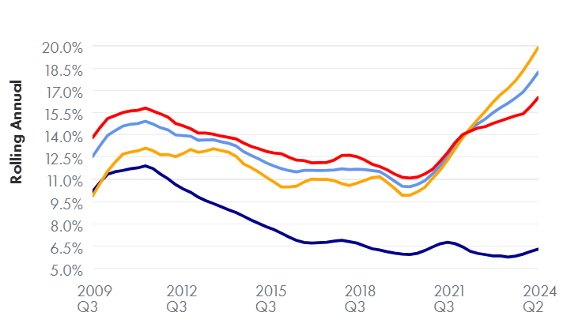

Office–Most Challenging Property Sector
Outlook remains very uncertain with significant downside risk
US Office Vacancy
WRH and other hybrid work habits have significantly impacted demand
  Hybrid work arrangements likely to be permanent
  Fully remote segment estimated at approximated 10-15%
Anemic Return to Office (RTO) rates in most key U.S. cities
Vacancy rates (approximately 20%) reached highest levels since early 1990s
  Versus pre-Covid level of 12.5% and GFC at 16.5%
  Sublease space reached record high in Q4
  25% of office inventory (1.1b 2sq ft) will be obsolete by 2030
Landlords offering significant concessions to attract tenants
Evidence of distress mounting as number of big office defaults rise
Tighter credit markets
Source: NCREIF, JLL Research, TA Realty, CoStar News, Nov 4 2022.

Slide 9
Office–Not all Bad News
Bifurcation in office sector with certain segments experiencing strong demand
  Newer, modern, well-amenitized, office properties in urban areas experiencing strong demand
  Limited demand for commodity type older office assets
  Flight to quality–occupiers focused on upgrading space
  Office properties constructed post 2015 experienced net absorption
  Upwards of 90% of office stock built pre-1990
Construction slow down
  Pace of deliveries slowed significantly
Increased focus on office conversions
  In 2022, 11.5 million sq ft of office converted or demolished
  Federal and municipal incentives to encourage conversions
Source: CBRE Q2 2022, Cushman and Wakefield

Slide 10
Real Estate
Market Update
General Education
Investor Sentiment
Real Estate Outlook
Sector Spotlight
Appendix

Slide 11
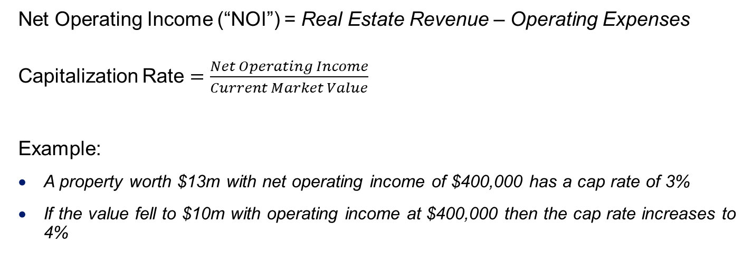
Real Estate–Cap Rates/Interest Rates
Cap Rate – ratio between the annual net income to current market value
Cap rate is effectively the yield of a property over a year
If the cap rate is greater than the interest rate, you’ll generally come out okay. If the cap rate is lower then the interest rate, you’ll be relying on appreciation for your return, which can mean that the investment has more risk.
Private Real Estate
  Net Operating Income (“NOI”) = Real Estate Revenue – Operating Expenses
  Capitalization Rate $=\frac{Net Operating Income}{Current Market Value}$
  Example:
    A property worth $13m with net operating income of $400,000 has a cap rate of 3%
    If the value fell to $10m with operating income at $400,000 then the cap rate increases to 4%

Slide 12
Real Estate Factors Impacting Cap Rates
Location: Proximity to employment & transit reduce cap rates
Condition: Class A properties tend to have lowest cap rates
Market Size: Larger markets tend to have lower cap rates
Sectors: Multifamily/industrial have lowest cap rates
Stability: Stabilized assets have lower cap rates
Property Level Factors
Cap rates measure risk and can be used to identify pockets of opportunity.
In general, the higher the cap rate, the greater the risk and return.
However, Net Operating Income excludes debt payments and capital expenditures. It also does not factor in market rent growth.
Lower cap rates are generally better for sellers and high cap rates are generally better for buyers
Macroeconomic Factors
Cap Rate
Inflation: High inflation is linked to interest rate hikes
Interest Rates: As interest rates rise, so do cap rates
Gross Domestic Product and Unemployment: Cap rates lower when GDP is high & unemployment is low
Notes:
Triangle Top Bottom Funnel pyramid arrow

Slide 13
Real Estate and Inflation
Certain types of real estate can serve as a hedge against inflation
Property types with shorter lease durations can reset rents as market conditions change
  Hotels, storage, apartments
Inflation-linked contracts
  Net Lease
Source: Cohen & Steers, “Recession and the roadmap for listed and private real estate”

Slide 14
Real Estate
Market Update
General Education
Investor Sentiment
Real Estate Outlook
Sector Spotlight
Appendix

Slide 15
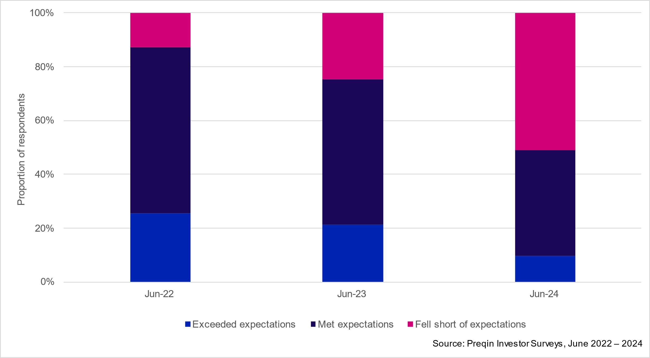
Challenges Facing Real Estate Investors Today
Investors today navigating uncertain waters
Disappointing real estate performance
  Recent Preqin study found approximately half of respondents were disappointed with their real estate performance over last 12 months
  NCREIF Property Index down 5.5%, ODCE 9.3% down and closed end funds experiencing even greater losses
  Cap rates have expanded across all property types
Limited price discovery
Limited liquidity
  Open-end funds restricting redemptions
  Closed-end funds seeking extensions
  Significant fall-off in distributions
Over allocation to real estate
Economic and political uncertainty & heightened geopolitical tensions
Real Estate Performance

Slide 16
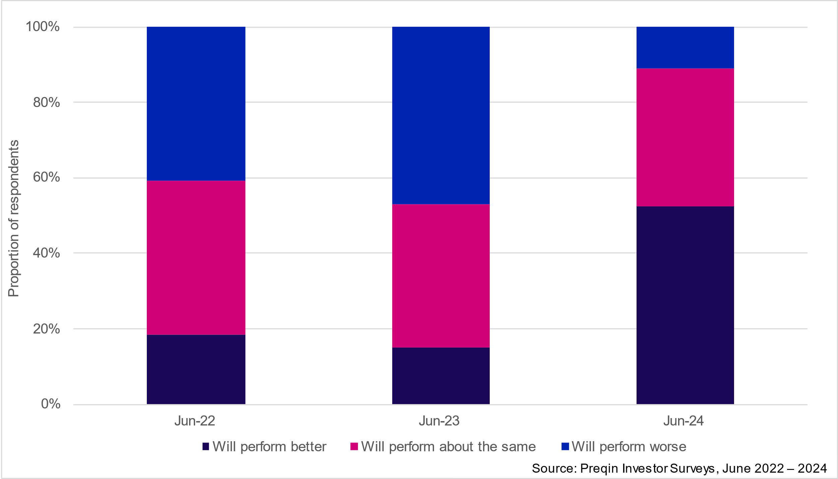
Sentiment Improving & Staying the Course
Expected interest rate cuts helping to alleviate concerns
  Negative sentiment has reached a turning point
    In 2024 Preqin study, over half of respondents expect real estate to perform better up from 15% in June 2023 survey
    Only 11% expecting worse results versus 47% in June 2023
  Majority of investors planning to keep allocation in short term and maintain or increase over longer term
    Over one third of respondents plan to increase their allocation, up from 25% in June 2023
    Drop in respondents planning to decrease allocation from 16% to 9%
  Strongest interest in core plus, value add and opportunistic funds
Performance Expectations for next 12 Months
Source: Preqin June 2024 Investor Outlook

Slide 17
Real Estate
Market Update
General Education
Investor Sentiment
Real Estate Outlook
Sector Spotlight
Appendix

Slide 18
Staying Alive until 2025
Glimmer of hope that close to bottom….
Returns remain negative but declines moderating
  Returns improving as cap rate expansion moderates and NOI growth remains positive
  Transaction market showing slight pick-up in pricing
  View that prices have bottomed
Anticipated interest rate cuts will revive real estate markets
Pick-up in transaction activity
Source: NCREIF NPI Q1 2024 Real Estate Performance Report

Slide 19
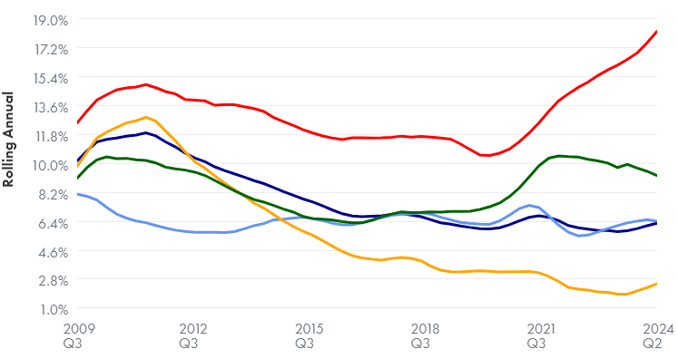
Real Estate Fundamentals
Some softening but real estate fundamentals remain relatively healthy
Low vacancy rates
  Vacancy rates continue to inch up in 2024 but remain near all time lows
  NPI vacancy rate of 6.4% as of Q2 versus long run average of 8.5%
  Industrial at 2.8% versus office at 19.2%
Strong leasing momentum and healthy NOI growth
  NOI resilient supporting strong income returns
  Significant gap between in-place and market rents should continue to support strong NOI
  NOI growth positive across all property types
  Pick-up in leasing momentum in H1 2024
Slowing economy/recession likely to dampen tenant demand
Vacancy Rates
U.S. Total U.S. Apartment U.S. Industrial
U.S. Office U.S. Retail
Source: CoStar, DWS, Bureau of Economic Analysis (Real Estate Construction Spending); National Bureau of Economic Research (Recessions), NCREIF

Slide 20
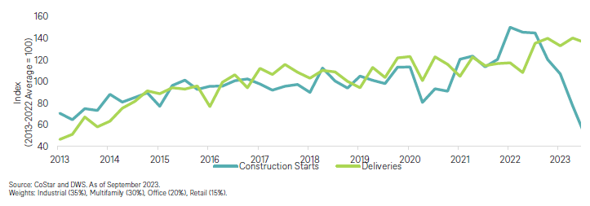
Real Estate Fundamentals
Some softening but real estate fundamentals relatively healthy
Limited new supply
  Unlike past cycles, over-supply is not an issue
  Labor shortages, supply chain issues and mounting material costs keeping development in-check
  Real estate construction spending down 18% since beginning of 2020
  Tighter credit markets and recessionary concerns likely to further dampen construction spend
  Construction spend predominately focused on housing and industrial sectors
RE Construction Starts and Deliveries
Source: CoStar, DWS, Bureau of Economic Analysis (Real Estate Construction Spending); National Bureau of Economic Research (Recessions), NCREIF

Slide 21
Opportune Time to Invest
Periods of dislocation have historically generated strong returns in following years
NPI Historical Returns
Declining valuations present buying opportunities
  Higher cap rates & relatively healthy fundamentals
  Potential to purchase below replacement value
Scarcity of capital
Distressed sellers
  Refinancing at higher rates
  Tighter credit markets
  Opportunity for rescue capital
Real estate debt
  Opportunity to originate safer credit investments at higher returns than in recent years
Source: NCREIF

Slide 22
Real Estate
Market Update
General Education
Investor Sentiment
Real Estate Outlook
Sector Spotlight
Appendix

Slide 23



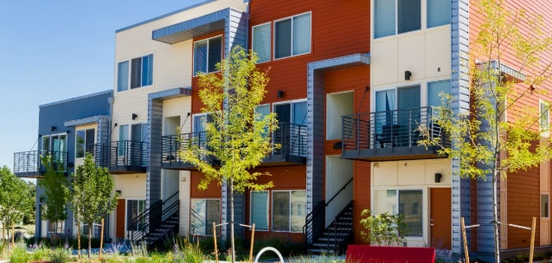

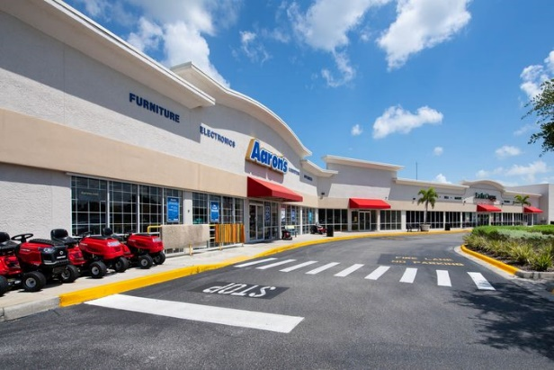

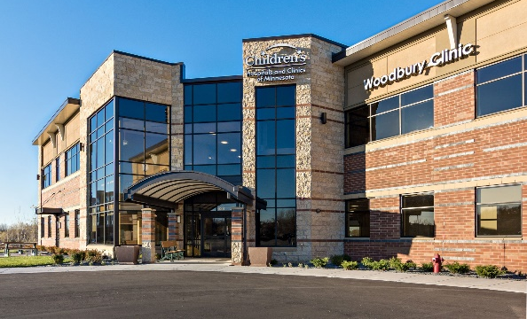
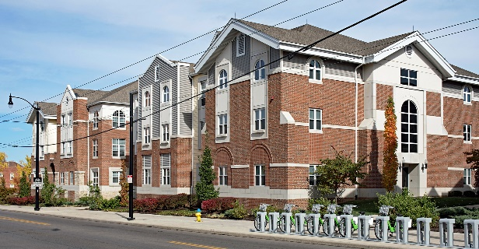
Real Estate Sectors
Core Property Types
Office – Multi-Family – Retail – Industrial
Other Property Types
Senior Living – Self-Storage – Hotel – Medical Office – Student Housing –Data Centers – Life Sciences
23
Notes:
Two
2
Icons
Callout
Two
Compare

Slide 24
Real Estate Outlook
Significant disparity across sectors:
Multifamily | Fundamental undersupply of U.S. housing Home ownership challenging due to low-inventory, elevated pricing and high mortgage rates Elevated construction costs, supply chain issues, higher debt costs and labor shortages keeping construction in check Over supply in certain markets will dampen near term performance
Industrial | Continued growth of e-commerce and shortening supply chains supporting strong demand for space Fall-off in construction starts should lead to under supply in certain markets Overall vacancy rates at record lows Aging warehouse inventory and shortage of newer modern assets
Office | Strong adoption of hybrid work arrangements likely to persist leading to continued downsizings and reduced uptake Anemic Return to Office (RTO) rates in most key U.S. cities - office re-entry rates in major markets stabilized in Q4 at just under 50% Vacancy rates (approximately 20.0%) reached highest levels since early 1990s Evidence of distress mounting as number of big office defaults rise Limited credit available for office assets
Retail | Supply rebalance supporting demand for space – new supply at record lows over last several years Vacancy rate at lowest level in 15 years Leasing demand in certain sectors very robust, particularly grocery anchored and neighborhood centers Malls and urban centers remain under pressure

Slide 25
Real Estate Outlook
Significant disparity across sectors:
Other Residential | SFR: Strong demographical tailwinds in addition to home affordability challenges driving demand Affordable Housing: Strong and stable tenant demand, undersupply in most markets Manufactured Homes: Limited supply, housing deficit for renter co-hort and affordability issues supporting demand
Student Housing | Sector benefiting from strong college enrollment and high occupancy rates Undersupply in certain markets
Hospitality | Recovery in sector supported by increases in leisure and group demand as well as business travel to a lesser extent Business sector slower to recover
Data Centers | Growth in cloud computing driving demand – advances in AI expected to fuel growth in coming years Vacancies at all time lows, driving record rental growth
Self Storage | Tenant demand strong - Sector benefiting from migration, WRH, uptick in household consolidation, downsizing Fragmented ownership creating opportunities
Senior Living | Ageing inventory of facilities with many now considered functionally obsolete Ageing population continues to support tenant demand

Slide 26
Residential–Short-term Headwinds
Price adjustment post-Covid demand surge
Slow down in mid-2022
  Household formation weakened amidst economic uncertainty
  Leasing activity slowed
  Net absorption turned negative
  Household formation moderated
Surge in new deliveries causing vacancy to increase and rental growth to decelerate
  Vacancy expected to peak in 2024 but fall thereafter as new deliveries slow
Valuations softening and cap rate expansion
In the near-term renter demand will struggle to keep pace with supply
Source: TA Realty, CBRE

Slide 27
Residential–Fundamentals Strong over Longer-term
Near-term headwinds but fundamentals remain solid
Strong structural demand drivers remain in place over longer term
Home ownership
  Median U.S. house prices have topped $450,000
  Share of homes affordable to a family earning the area median income has fallen dramatically
  30-year mortgage rates have more than doubled to approx. 7%
  Cost of renting versus buying at widest gap on record
Elevated construction costs, supply chain issues, higher debt costs and labor shortages keeping construction in check
Fundamental undersupply of U.S. housing
Effective Market Rents vs Monthly Mortgage Payments
Source: DWS, Federal Reserve Bank of St. Louis.
Notes:
CBRE calculates that the average house payment for a newly purchased home in Q3 2022 was 57% more expensive than the average monthly apartment rent, the widest cost gap on record. The premium averaged just 8.5% before the pandemic

Slide 28
Industrial–Still Going Strong
Demand has moderated but fundamentals remain healthy
Shift from just-in-time to just-in-case philosophy
Continued growth of e-commerce
  Infrastructure required to support faster deliveries
CHIPS & Science Act creating new opportunities in manufacturing and R&D
  Domestic production of semiconductors & supporting R&D efforts in new technologies
  $280b to support domestic production
Industrial leasing remains strong despite pull-back from certain large tenants
  Recent CBRE study found that 64% of industrial tenants are planning to increase their footprint
  Sector has enjoyed record NOI growth
Overall vacancy rates at record lows of approximately 4.0%
  Major ports report even lower vacancy rates at around 2%
  Year-end NPI vacancy of 1.6% was lowest level since 1988
Aging warehouse inventory
  Shortage of newer, modern assets
  Replacement costs rising
Significant new supply but demand for space strong
  Supply pipeline at record highs
  65% pre-leased versus long run average of 40%
  Rent growth expected to decelerate as new space comes to market
  New construction starts stalled in Q4
Source: TA Realty, CBRE, DWS.

Slide 29
Retail–A Mixed Bag
Supply rebalance supporting momentum but recovery uneven
U.S. retail overbuilt? Not anymore
  New supply deliveries at record lows
  Older and/or obsolete space being demolished or converted
Despite inflationary pressures, surge in demand for retail space
Strong demand for services and experiences post-Covid
Certain sub-sectors poised for continued growth, others not so much
  Suburban shopping centers, grocery anchored neighborhood and community centers benefiting from (i) work from home, (ii) necessity retail and (iii) typically service oriented stores
  Conversely, malls and urban centers under pressure
E-commerce–Friend or Foe?
  Jumped from 14% to 21%
  E-Commerce remains elevated versus pre-Covid levels
  Retailers adopting a dual approach
Inflation–significantly impacting consumer sentiment and ultimately spending
  Lower and middle-income consumers hit hardest
  Non-essential spending down, focus on necessities
  Greater focus on discount and lower cost brands as well as services, travel and entertainment
Source: JLL Retail Outlook 2023, CoStar, PNC Creditntell

Slide 30
Hotels–Having their Day in the Sun
Strong rebound on back of pent-up demand
Lagged other sectors during initial stages of recovery but has since outperformed
  Only sector posting positive one-year returns (up 6.7%)
Recovery in sector supported by increases in leisure and group demand as well as business travel to a lesser extent
  Drive-to-leisure lead the way for sector’s recovery
  All leisure types now experiencing strong demand
  Group and commercial demand has lagged leisure
Slow down in supply
Excellent inflation hedging capabilities–can adjust rates daily
Labor shortages a concern
Insurance premiums related to climate change on the rise

Slide 31
Niche Sectors Going Mainstream
Niche sectors provide for increased diversification and alpha
Increasing importance in institutional portfolios
  Investment in alternative property types grown at expense of office and retail
  Now represents largest component of FTSE Nareit Index
  Growing component of ODCE funds
Wide variety of alternative property types covering:
  Housing (Student, Senior, Active Adult, Manufactured Homes, SFR, Vacation Rentals, Affordable Housing)
  Technology (Data centers, Life Sciences)
  Healthcare (Medical Office)
Different demand drivers than main property types
  Demographic driven versus GDP driven
REIT Market Composition: 2007 vs Today
Source: CenterSquare, FTSE NAREIT All Equity REITs

Slide 32

Niche Sector–Single Family Rental
Growing component of the rental housing market
Fragmented information and ownership create opportunities
  Only 3-5% held by institutions
  Institutional ownership expected to grow to 40% by 2030
  Technology advances overcoming sector inefficiencies
Strong demographical tailwinds driving demand
  Aging millennials likely to seek larger living units
  Large cohort of renters-by-choice
Home affordability challenges creating necessity renters
  Higher mortgage rates a deterrence to home ownership
  Home prices have escalated
    Median new home price in the U.S. increased 22% since 2020 while existing home prices increased by 58%
Undersupply of single-family homes as construction has lagged demand
32

Slide 33

Niche Sector–Self Storage
Returns moderated but outlook remains positive
Sector gaining increased attention from institutional investors
  Significant allocation in many core funds
  Large part of listed REIT universe
Tenant demand soared during Covid and remains strong
  Sector benefiting from migration, WRH, uptick in household consolidation, downsizing
  Low vacancies supporting strong rental growth
Construction at elevated levels
  Trending downward following peak
  New construction focused on chronically undersupplied markets
  NIMBYism
Strong inflation hedge
  Month-to-month lease structures
33

Slide 34


Niche Sector–Data Centers
Data centers–real estate or infrastructure?
Hybrid asset type that fits in either real estate or infrastructure
Demand for data centers has increased exponentially with attractive growth prospects
  For the most part, companies prefer to outsource their data center needs
  The shift to / adoption of cloud computing
  Roll out of 5G networks capable of handling more data
  U.S. data center demand expected to grow by 10% a year until 2030
Vacancy at a low point due to strong demand from hyperscale users
Fragmented information and ownership structures
Resilient asset class
Source: TA Realty
34

Slide 35
Real Estate
Market Update
General Education
Investor Sentiment
Real Estate Outlook
Sector Spotlight
Appendix

Slide 36
How to Invest in Real Estate
Implementation/selection of a vehicle/strategy will include varying additional fees such as legal and consulting which should be reviewed.
Average Fees
Open End Commingled Fund
Typically for Core and Core Plus Real Estate
Quarterly Liquidity in Normal Market Environment
Primary Closed End Limited Partnership
Typically a 10-year term
Secondary, Fund of Funds & Co-Investments
Lesser Part of Real Estate Universe
REITs
Diversified Portfolio
Value-Add and Opportunistic Strategies primarily
More concentrated Portfolio
Blind Pool Risk
Highly diversified portfolio
Typically a 10+ year term
Double Layer of Fees and Expenses
Publicly Traded
Daily Liquidity
Large, diverse investment universe
Attractive income return
Increased volatility compared to private real estate
Moderately levered at 20% - 45%
Leverage 60%+
Leverage up to 40% for core, up to 55% for core plus.
Management Fee: 0.8%–1.2%
No Performance Fee¹
Management Fee: 1.5%–1.75%
Performance Fee¹: 15%–20%
Management Fee: 0.5%–1.0%
Performance Fee¹: 0%–10%
Additional fees include the fees of the underlying vehicle (see open/closed end fees above)
Management Fee: 0.7%–0.9%
1.) A performance fee (also known as carried interest) is the percentage of profits that general partners receive out of the investments made by the fund. Typically carried interest is only paid after limited partners receive their original investment back as well as a preferred return.

Slide 37




Real Estate Equity Risk Spectrum
Stable/Low Volatility
Enhanced Return
High Return/High Volatility
Expected Return
Opportunistic
Expected Return: 15%–18%
Leverage: 60%–75%
Value Added
Expected Return: 12%–15%
Leverage: 60%–65%
Core Plus
Expected Return: 9%–13%
Leverage: 30%–55%
Core
Expected Return: 7%–9%
Leverage: 15%–25%
Expected Risk
Manager Expertise

Slide 38

Thank You
38
Notes:
Thank you question section q&a divider orange

